Slide 1
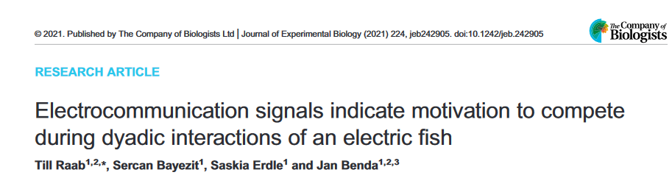
Competition in A. leptorhynchus - How and why ?
Notes:
Electrocommunication signals indicate motivation to compete during dyadic interactions of an electric fish

Slide 2
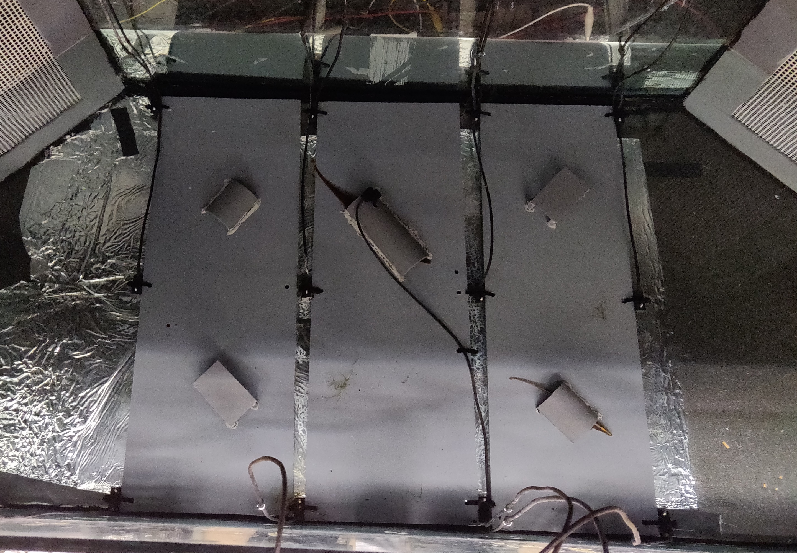
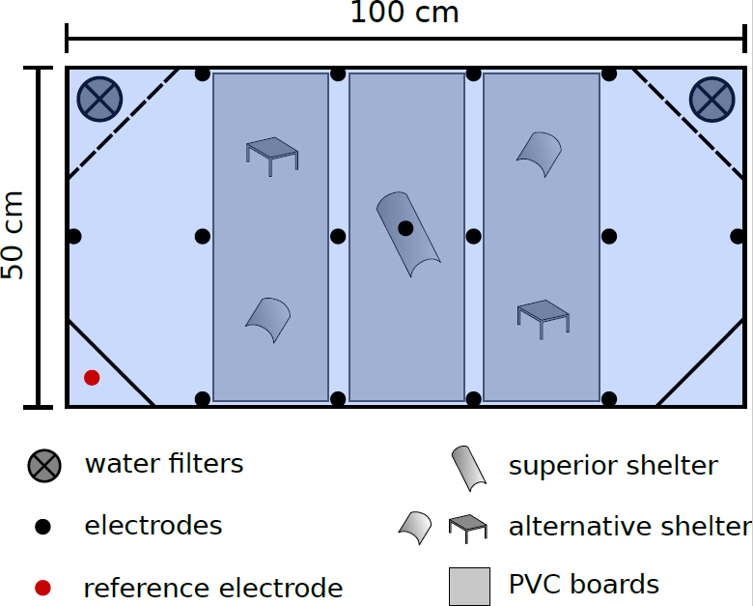
Staged competitions
Experimental condition:
pairs of fish
competition for a superior shelter
6h trials
3h/3h dark/light

Slide 3
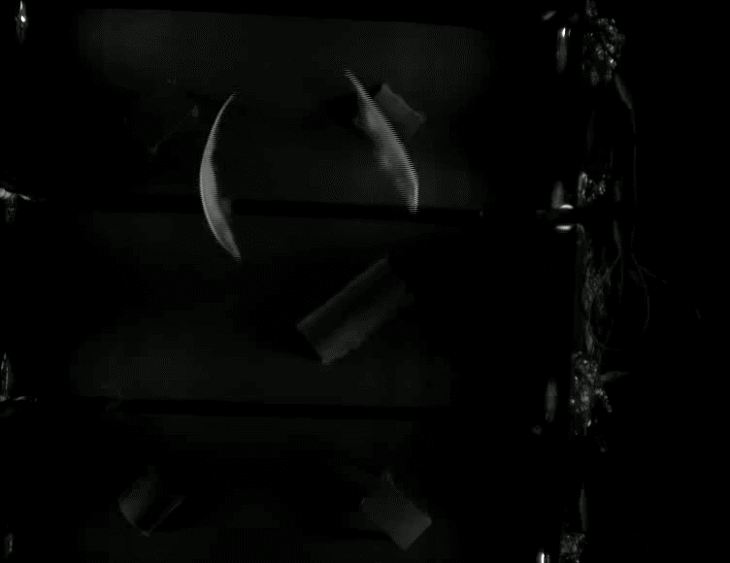
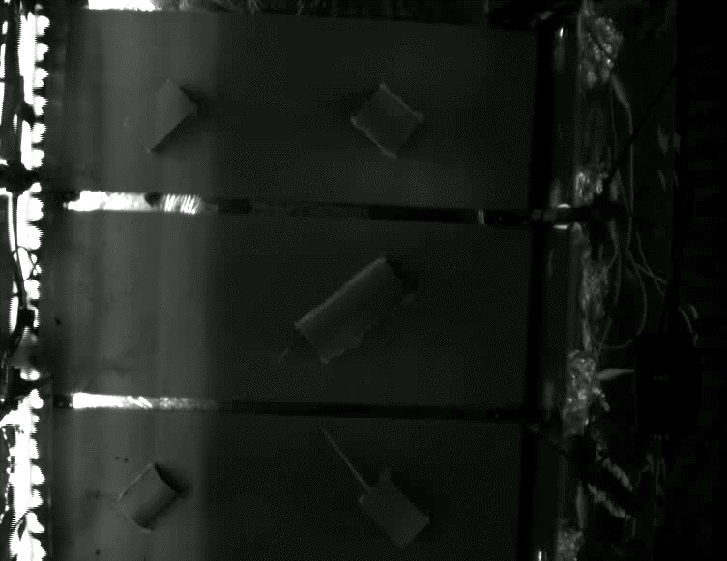
Staged competitions
Dark
Light

Slide 4
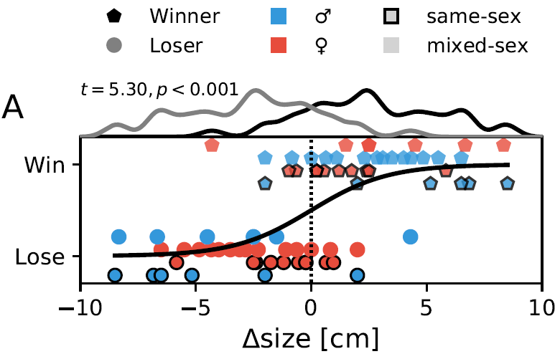
Winners are determined by a larger body-size
… body-size
… EOD frequency
… sex

Slide 5
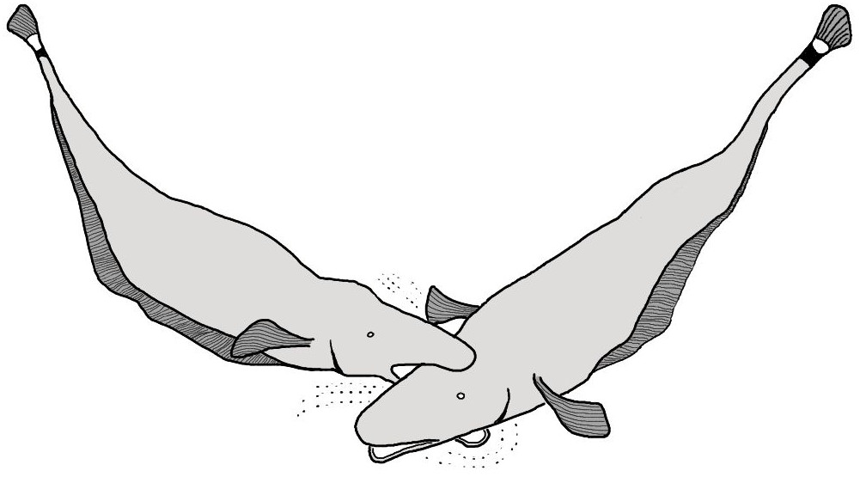
Interactions during dyad competitions
Agonistic interactions

Slide 6
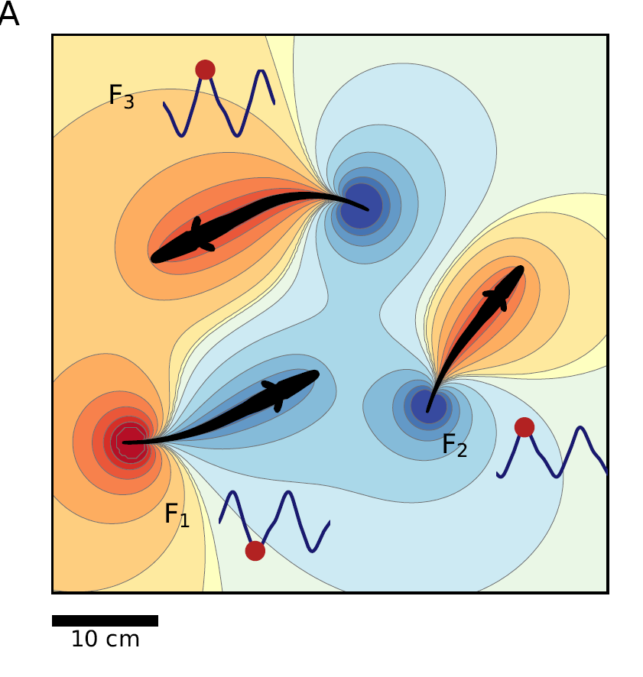
Interactions during dyad competitions
Agonistic interactions
Electrocommunication

Slide 7
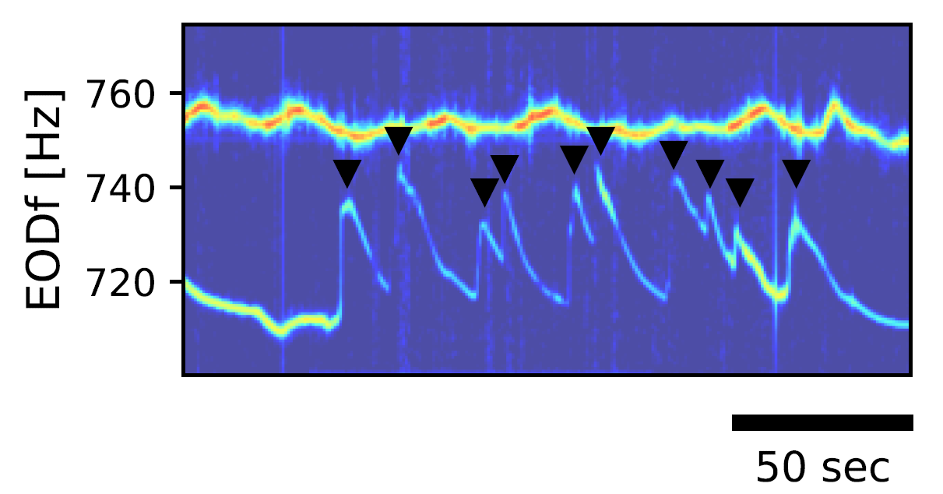
Interactions during dyad competitions
Agonistic interactions
Electrocommunication
with rises

Slide 8
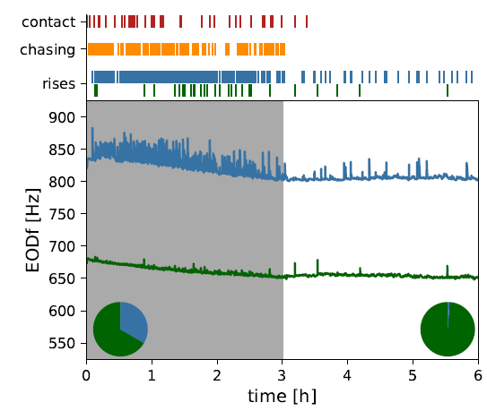
Interactions during dyad competitions
Dark phase (active):
agonistic encounters
many rises

Slide 9
Interactions during dyad competitions
Dark phase (active):
agonistic encounters
many rises
Light phase (inactive):
less interactions

Slide 10
Interactions during dyad competitions
Dark phase (active):
agonistic encounters
many rises
Light phase (inactive):
less interactions
winners occupy shelter

Slide 11
Interactions during dyad competitions
Dark phase (active):
agonistic encounters
many rises
Light phase (inactive):
less interactions
winners occupy shelter
Losers emit Rises
→ Winners initiate attacks

Slide 12
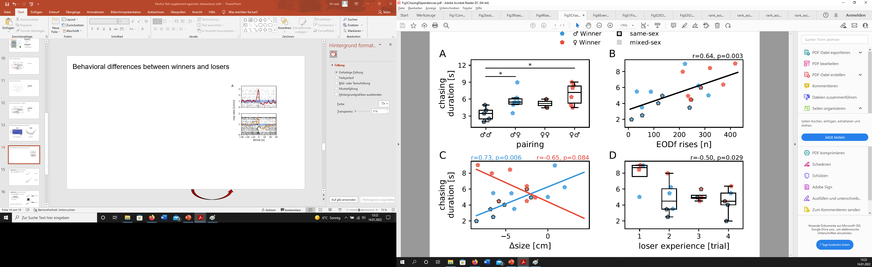
Rises affect agonistic events
more rises
longer chasing events

Slide 13
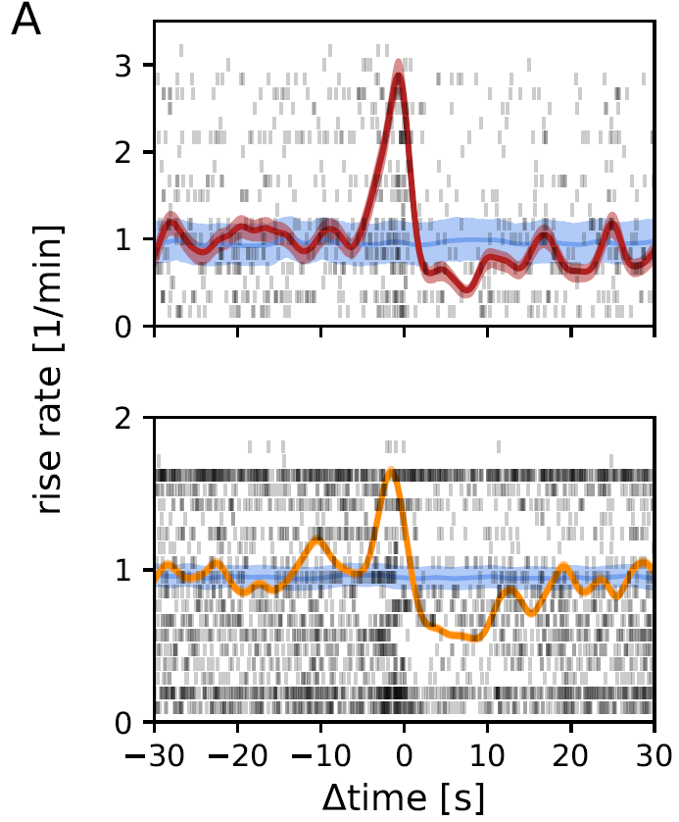
Rises affect agonistic events
more rises
longer chasing events
Rises trigger…
physical attacks chasing events

Slide 14
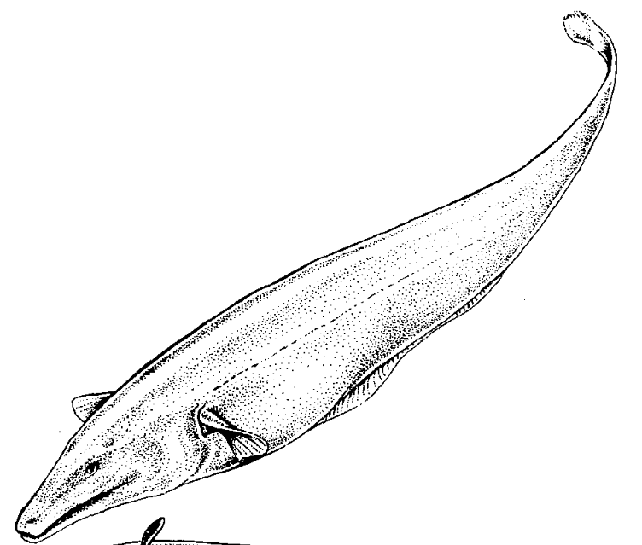
A. leptorhynchus assess their opponents
Resource Holding Potential (RHP) ~ body-size
RHP (fish 1)
RHP (fish 2)

Slide 15
A. leptorhynchus assess their opponents
Resource Holding Potential (RHP) ~ body-size
RHP (fish 1)
Self assessment
Accumulate competition costs:
from own actions
RHP (fish 2)

Slide 16
A. leptorhynchus assess their opponents
Resource Holding Potential (RHP) ~ body-size
RHP (fish 1)
Self assessment
Accumulate competition costs:
from own actions
RHP (fish 2)
Retreat when RHP threshold is reached

Slide 17
A. leptorhynchus assess their opponents
Resource Holding Potential (RHP) ~ body-size
RHP (fish 1)
Cummulative assessment
Accumulate competition costs:
from own actions
Inflicted by opponent
RHP (fish 2)
Retreat when RHP threshold is reached

Slide 18
A. leptorhynchus assess their opponents
Resource Holding Potential (RHP) ~ body-size
RHP (fish 1)
Mutual assessment
Estimate ΔRHP:
Repetitive RHP probing
Ritualized non-severe fighting
RHP (fish 2)
Adjust behavior according to ΔRHP

Slide 19
How to distinguish assessment models

Slide 20
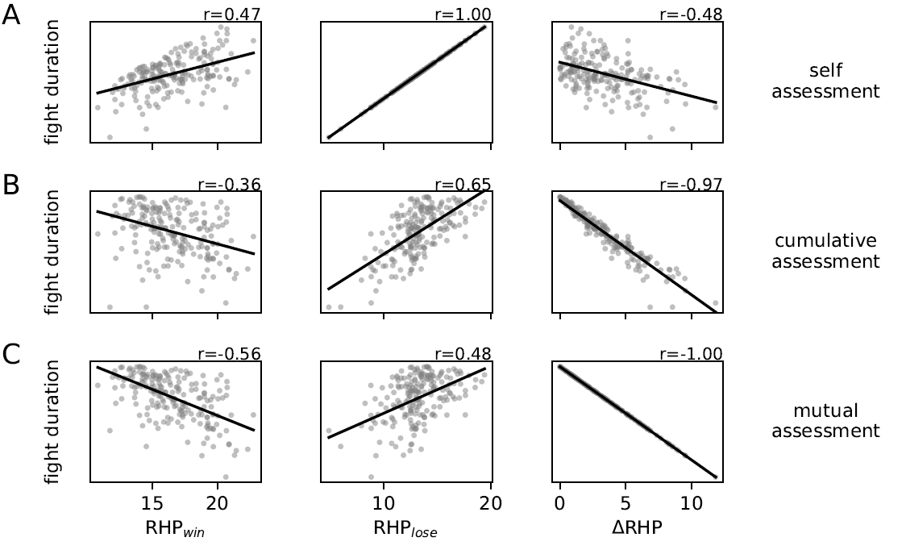
How to distinguish assessment models
Symulations
Estimae the effect of …
… body-size_{win}
… body-size_{lose}
… Δ body-size
on competition behavior across assessment models.
Resource Holding Potential (RHP) ~ body-size

Slide 21
How to distinguish assessment models
Symulations
Estimae the effect of …
… body-size_{win}
… body-size_{lose}
… Δ body-size
on competition behavior across assessment models.
Resource Holding Potential (RHP) ~ body-size

Slide 22
How to distinguish assessment models
Rise count & chase duration
Resource Holding Potential (RHP) ~ body-size

Slide 23
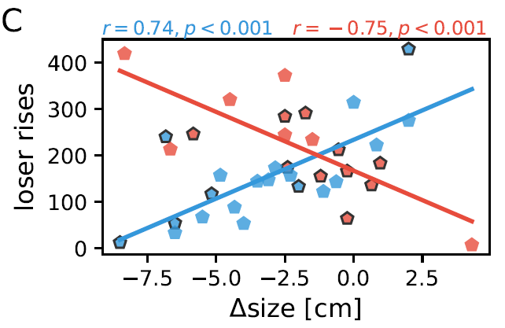
How to distinguish assessment models
Rise count & chase duration
unaffected by body-size_{win}
unaffected by body-size_{lose}
increase with Δbody-size
Resource Holding Potential (RHP) ~ body-size

Slide 24
How to distinguish assessment models
Rise count & chase duration
unaffected by body-size_{win}
unaffected by body-size_{lose}
increase with Δbody-size
Resource Holding Potential (RHP) ~ body-size
♂ losing against ♀ represent an exception

Slide 25
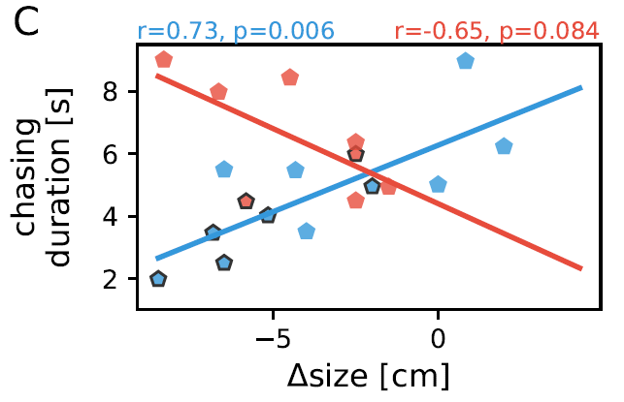
How to distinguish assessment models
Rise count & chase duration
unaffected by body-size_{win}
unaffected by body-size_{lose}
increase with Δbody-size
Resource Holding Potential (RHP) ~ body-size

Slide 26
How to distinguish assessment models
Rise count & chase duration
unaffected by body-size_{win}
unaffected by body-size_{lose}
increase with Δbody-size
Fighting behavior
Repetitive ritualized fighting

Slide 27
How to distinguish assessment models
Rise count & chase duration
unaffected by body-size_{win}
unaffected by body-size_{lose}
increase with Δbody-size
Fighting behavior
Repetitive ritualized fighting
Resource Holding Potential (RHP) ~ body-size
A. leptorhynchus use mutual assessment during competitions

Slide 28
The function of rises during competitions

Slide 29
The function of rises during competitions
Rises
agonistic interactions

Slide 30
The function of rises during competitions
Rises
agonistic interactions
More Rises
longer chasing events

Slide 31
The function of rises during competitions
Rises
agonistic interactions
More Rises
longer chasing events
Smaller Δbody-size
More rises

Slide 32
The function of rises during competitions
Rises
agonistic interactions
More Rises
longer chasing events
Smaller Δbody-size
More rises
Rises as a signal of motivation during competitions

Slide 33
The function of rises during competitions
Rises
agonistic interactions
More Rises
longer chasing events
Smaller Δbody-size
More rises
But … why?
Rises as a signal of motivation

Slide 34
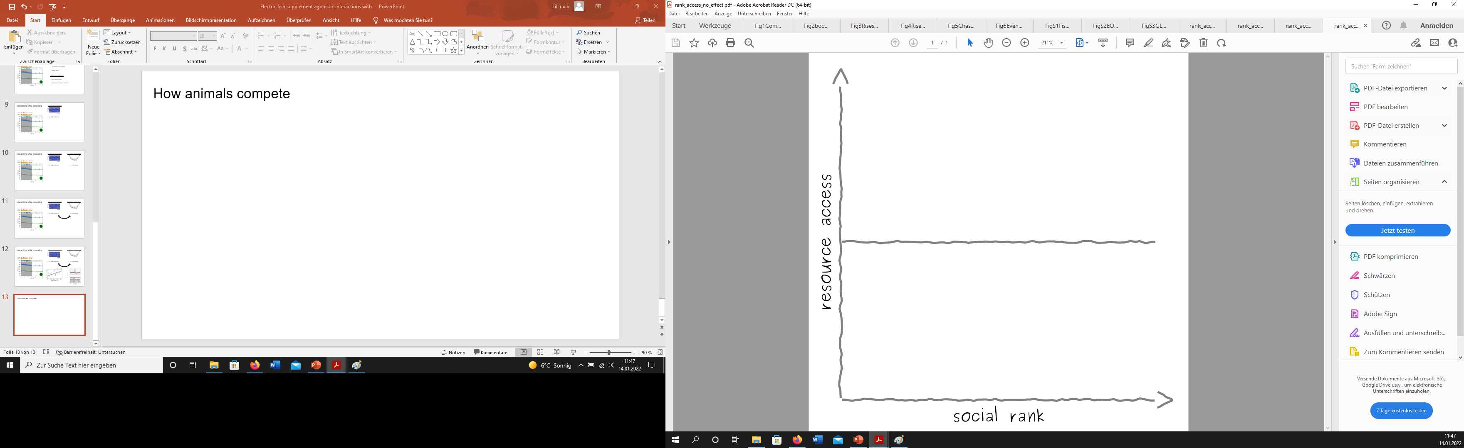


Organization of dominance hierarchies
despotic
egalitarian

Slide 35
Organization of dominance hierarchies
despotic
egalitarian
Significance of social rank

Slide 36
Organization of dominance hierarchies
despotic
egalitarian
Significance of social rank
Resources

Slide 37
The dominance hierarchy in A. leptorhynchus
despotic
egalitarian
Ritualized fighting to adjust skewness in acess to resources

Slide 38
The dominance hierarchy in A. leptorhynchus
despotic
egalitarian
Ritualized fighting to adjust skewness in acess to resources

Slide 39
The dominance hierarchy in A. leptorhynchus
despotic
egalitarian
Ritualized fighting to adjust skewness in acess to resources
Rises and agonistic inteactions coordinate this process

Slide 40
The dominance hierarchy in A. leptorhynchus
despotic
egalitarian
Ritualized fighting to adjust skewness in acess to resources
Rises and agonistic inteactions coordinate this process
Increased resource valuation in males could explain deviating behavior

Slide 41
The dominance hierarchy in A. leptorhynchus
despotic
egalitarian
Ritualized fighting to adjust skewness in acess to resources
Rises and agonistic inteactions coordinate this process
Increased resource valuation in males could explain deviating behavior

